Slide 1

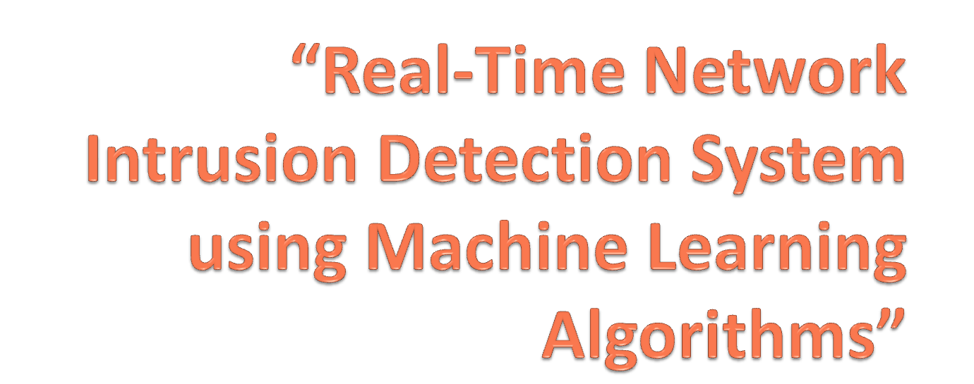
By:
Sampada Pingale(37)
Mrinal Bhalerao(44)
Anjum Pathan(06)
Jyoti Bhole(39)

Slide 2
Problem Statement
“To implement effective Real-Time Network Intrusion Detection System to reduce False alarm rate and improve efficiency, using machine learning technique.”

Slide 3
Why?
Data Security
Signature based Vs Anomaly based
Very few existing system have been implemented for REAL TIME using MACHINE LEARNING.
Firewall Vs NIDS

Slide 4

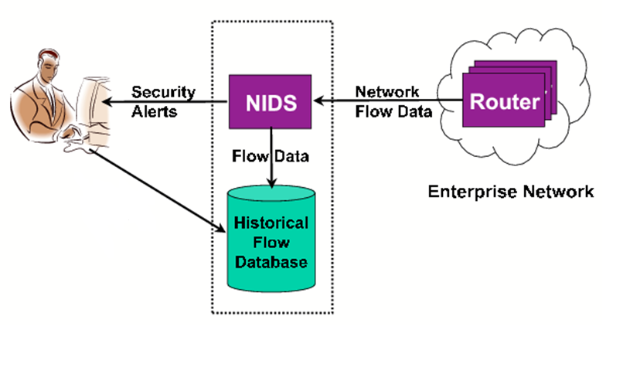

Slide 5

Provide a wall of defense to confront the attacks of computer systems on Internet.
Collects information from a network analyzes the information for symptoms of system breaches.
Monitors network data
Gives an alarm, when detects antagonistic activity on an open port.

Slide 6

Anomaly detection system has the potential to
generate too many false alarms.
4 quadrants based on the result obtained by the NIDS:
True Positive: attack data detected as attack data.
True Negative: normal data detected as normal data.
False Positive: normal data is detected as attack data.
False Negative: attack data is detected as normal data.

Slide 7



Slide 8
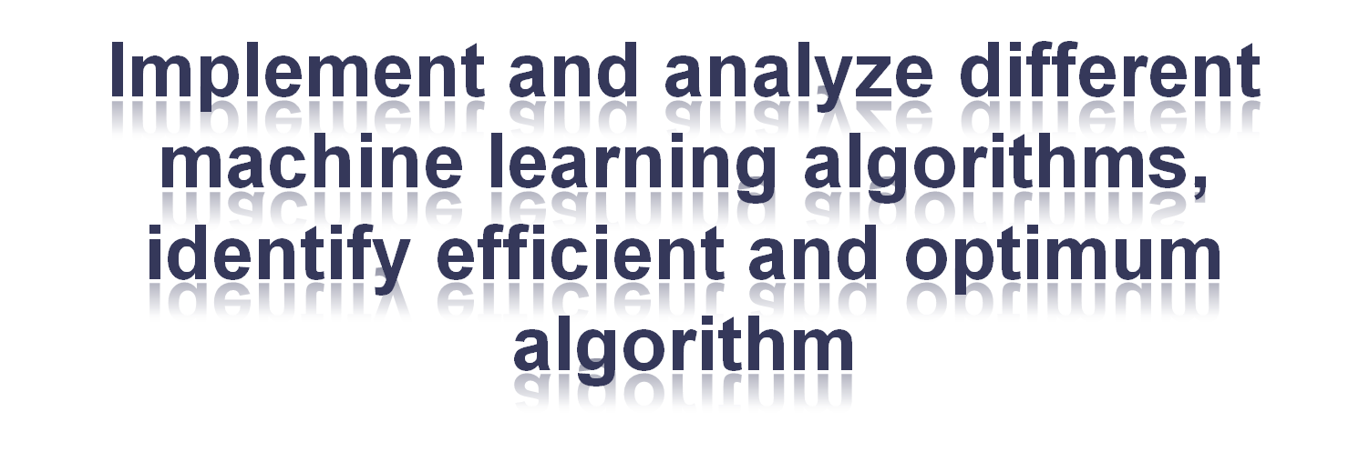




Slide 9
Literature survey and Domain Study

Slide 10
Papers Studied
Practical real-time intrusion detection using machine learning approaches
Real-time network intrusion detection system (RT-IDS) model which can be used with existing well-known machine learning algorithms.
Our RT-IDS model consists of three phases:
1. Pre-processing phase
2. Classification phase
3. Post-processing phase.

Slide 11
Papers Studied
Also presented are how we preprocess the network packet header data into records of ‘n’ essential features
The algorithms used in this paper are:
  Decision Tree
  Ripper Rule
  Back Propagation Neural N/w
  KNN

Slide 12
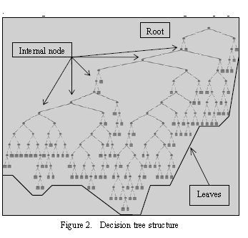
Decision Tree
A Decision Tree consists of non-terminal nodes and terminal nodes.
First, the Decision Tree is trained with known data
The training process builds the Decision Tree by identifying attributes and values
After training, the tree can predict or classify new data by starting from a root node and traversing internal nodes based on attributes of test conditions until it arrives at a leaf (terminal) node consisting of an answer class.

Slide 13
Papers Studied…
Real-time anomaly detection systems for Denial-of-Service attacks by weighted k-nearest-neighbor classifiers
Ming-Yang Su
  Genetic Algorithm
  K-Nearest Neighbors

Slide 14
Papers Studied(cont.)
This study proposed a method to weigh features of DoS/DDoS attacks, and analyze the relationship between detection performance and number of features.
The proposed method can be implemented to a real-time NIDS, since all features applied in this study were directly collected from packet headers.
All 35 features were evaluated and weighted.
According to the experiments on DoS/DDoS attacks, for known attack
  the best overall accuracy was 97.42%, for which only top 19 features
  the best overall accuracy was 78%, for which top 28 features were considered.

Slide 15
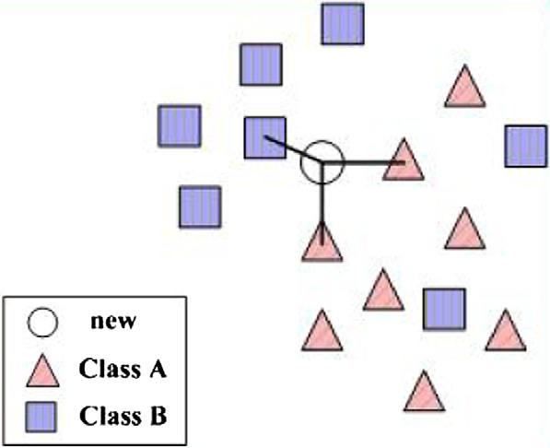
K-NN
FIG. K-NN ALGORITHM

Slide 16
Papers Studied…
Real-time Intrusion Detection and Classification
  Phurivit Sangkatsanee, Naruemon Wattanapongsakorn, and Chalermpol charnsripinyo

Slide 17
Software Requirement Specification

Slide 18
Packet Sniffers
For Windows:
  Capsa Network Analyzer
  Microsoft Network Monitor
  Wireshark (formerly known as Ethereal)
For Unix:
  dSniff
  NarusInsight
  Ngrep
  snoop
  tcpdump

Slide 19
Attacks
DoS (Denial of service)
Probe
R2L (Remote to local)
U2R (User to Root)

Slide 20
I) Denial of service attacks…
A denial-of-service attack is an attempt to make a machine or network resource unavailable to its intended users.
It generally consists of the efforts of one or more people to temporarily or indefinitely interrupt or suspend services of a host connected to the Internet.

Slide 21
II) PROBE
Program/device inserted at a key juncture in a network
for purpose of monitoring or collecting data about n/w activity
  IP Sweep
  PortSweep

Slide 22
III) R2L (Root to Local)
  Ncftp
  ntfsdos

Slide 23
IV) U2R (User to Remote)
  Remotely access a computer without having authority

Slide 24
C. Machine Learning
Branch of AI for scientific design and improvement of algorithms
i/p→empirical data
o/p→patterns/features of the underlying mechanism that generated the data

Slide 25
C. Machine Learning(cont.)
Approaches
  Decision tree learning
  Association rule learning
  Artificial neural networks
  Genetic programming
  Clustering
  Bayesian networks

Slide 26
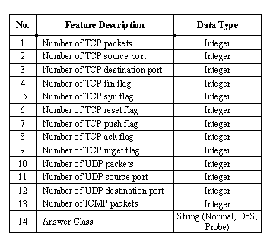
Packet Features

Slide 27
Modules of the project
1. PACKET CAPTURING
1.1 Packet sniffer to detect packets that are incoming to host
1.2 Extract Suitable/ necessary features of the packet headers

Slide 28
Modules of the project (cont.)
2. TRAINING
2.1 Train the i/p data with known answer classes
2.2 Test this i/p data
2.3 Algorithms for the same are implemented

Slide 29
Modules of the project (cont.)
3. TESTING
3.1 Use unknown data
3.2 Test the data and detect the intrusion, if any
3.3 Compare the results of all algorithms

Slide 30
Modules of the project (cont.)
4. False alarm detection and Reduction
4.1 Analyze performance of system
4.2 Compare results of algorithms for false alarms
4.3 Reduce the false alarm rate

Slide 31
User classes and Characteristics
  User class: Normal user
  Perform Authentication
  Can start system
  Give Choice of algorithm
  Perform testing
  User Class : Network Admin
  Perform Authentication
  Can start system
  Give Choice of algorithm
  Perform testing
  Perform Training
  Change dataset

Slide 32
Operating Environment
The target operating system of IDS is:
  Linux
  and
  Windows.
The solution should be developed such that it can smoothly run on several different distributions of Linux and Windows Operating Systems.
The programming language used are:
iPython
OR
Java

Slide 33
Design and Implementation Constraints
Processing Power:-
IDS requires high speed processing machine is required to fulfill all the tasks.
Deployment Point:-
We will get data from the real-time sources like a packet sniffer.
Detection/False Alarm Rate:-
Detection and false alarm rates depend on the choice of algorithm from user. With detections, come a number of false alarms as well. There will be further release of IDS in future that will improve these parameters in future.
Operating Platform:-
IDS will work well for Windows and Linux.

Slide 34
Assumptions and Dependencies
Assumptions of Minimum Requirements:
  Intel Pentium IV
  HardDisk Space : 40 GB
  Monitor : 14” Inches
  Keyboard : 104 Keys
  Internal Memory : 256 MB RAM
  Mouse : Optical Mouse
Dependencies:
  Packet Sniffer for Windows(anyone):
  Capsa Network Analyzer
  Microsoft Network Monitor
  Wireshark (formerly known as Ethereal)
  Monitoring and analyzing traffic

Slide 35
System Features
Online NIDS
Obtain highest detection rate and reduce FAR
Implement and analyze different machine learning based algorithms (based on information gain), identify efficient and optimum algorithm

Slide 36
External Interface Requirements
User Interfaces
User Interface will be a GUI application developed in Java or other UI language satisfying all required elements to interact with system.

Slide 37
Hardware Interface
Host
  Internal computer sources
  Ex: OS audit and system logs
Network
  Packets via “sniffing”
Target-based
  Monitor object for changes
  Ex: Tripwire

Slide 38
Software Interface
  Sniffers
    collect data from various sources such as log files, network packets
    sends them to the analyzer
  Analyzers
    process data from sensors and determine if intrusion has occurred
    may also provide guidance for the actions to take

Slide 39
Communication Interfaces
  Graphical User interface
    Select operations
    view the output and manage the behavior

Slide 40
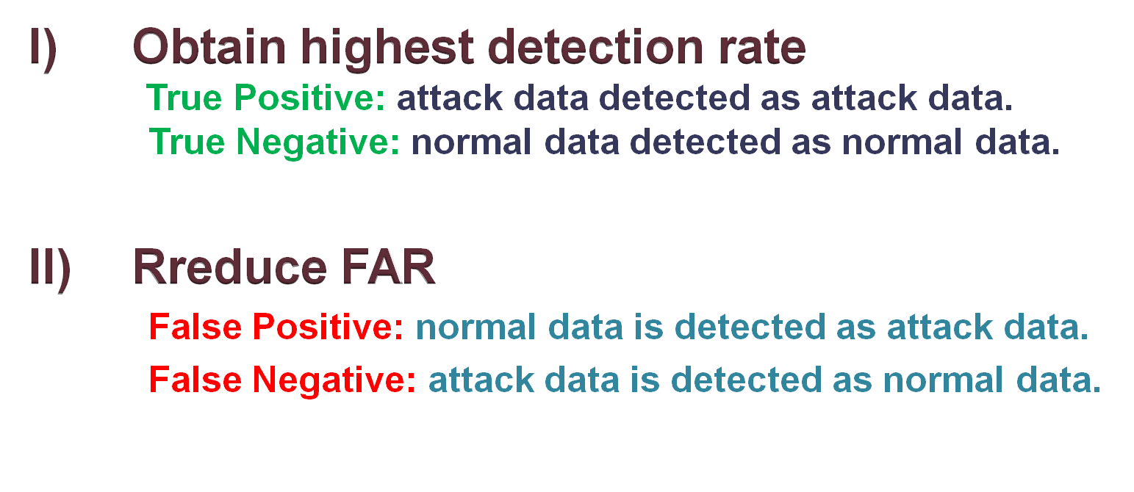
Non-functional Requirements
Performance Requirements

Slide 41
Safety Requirements
Computer security goals:
  Confidentiality, integrity, and availability
Intrusion is a set of actions aimed to compromise these security goals
Intrusion prevention (authentication, encryption, etc.) alone is not sufficient
Intrusion detection is needed

Slide 42
Security Requirement(cont.)
Security describes measures that are designed to deny access to unauthorized personnel
Security From Different type of attacks:
  DoS
  Probe
  R2L
  U2R

Slide 43
Software Quality Attribute
Attributes:
  Response
  Mean time to failure
  Mean time to recover

Slide 44
Other Requirements
Database Requirements
  Dataset
  Answer class
  Log File
  Trained Dataset

Slide 45
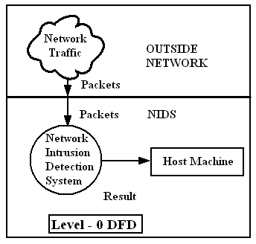
Analysis Model
Data flow diagram
A. Level 0

Slide 46
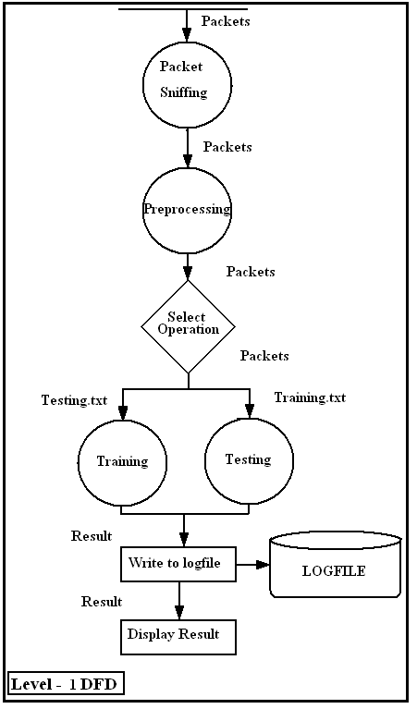
B. Level 1

Slide 47
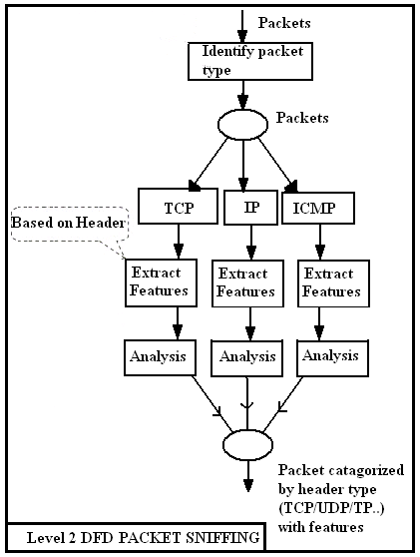
C. Level 2
(Sniffing)

Slide 48
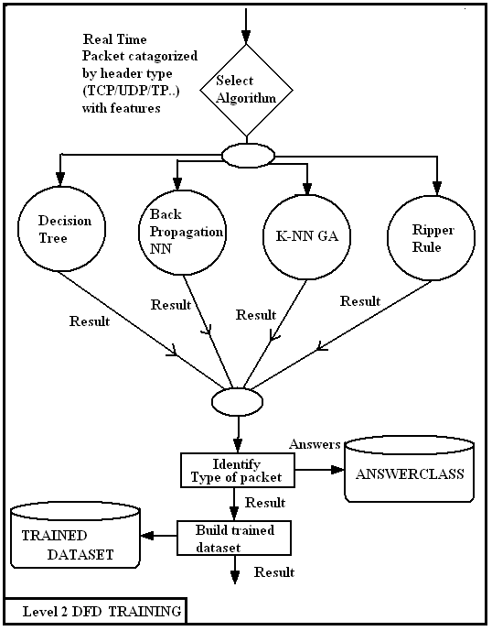
C. Level 2
(Training)

Slide 49
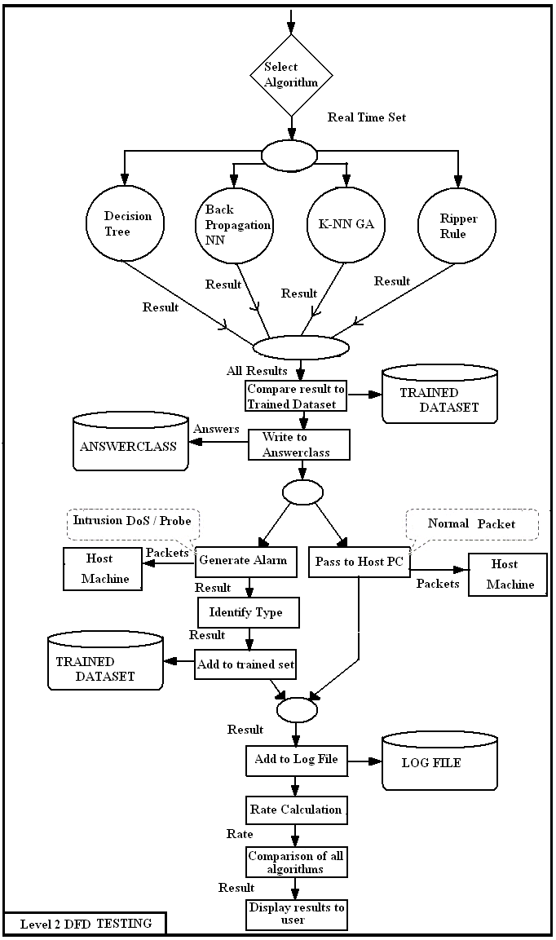
C. Level 2
(Testing)

Slide 50
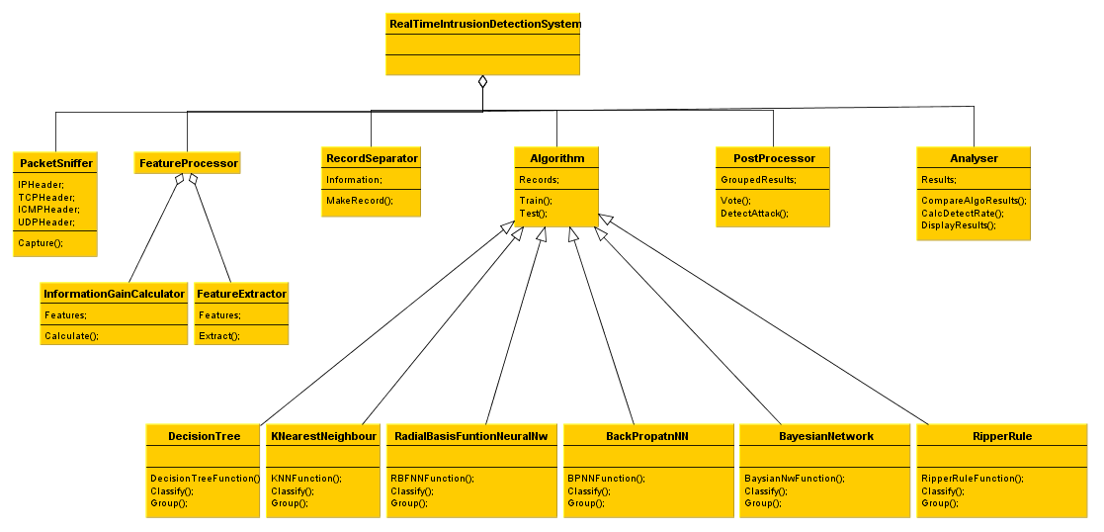
Class diagram

Slide 51
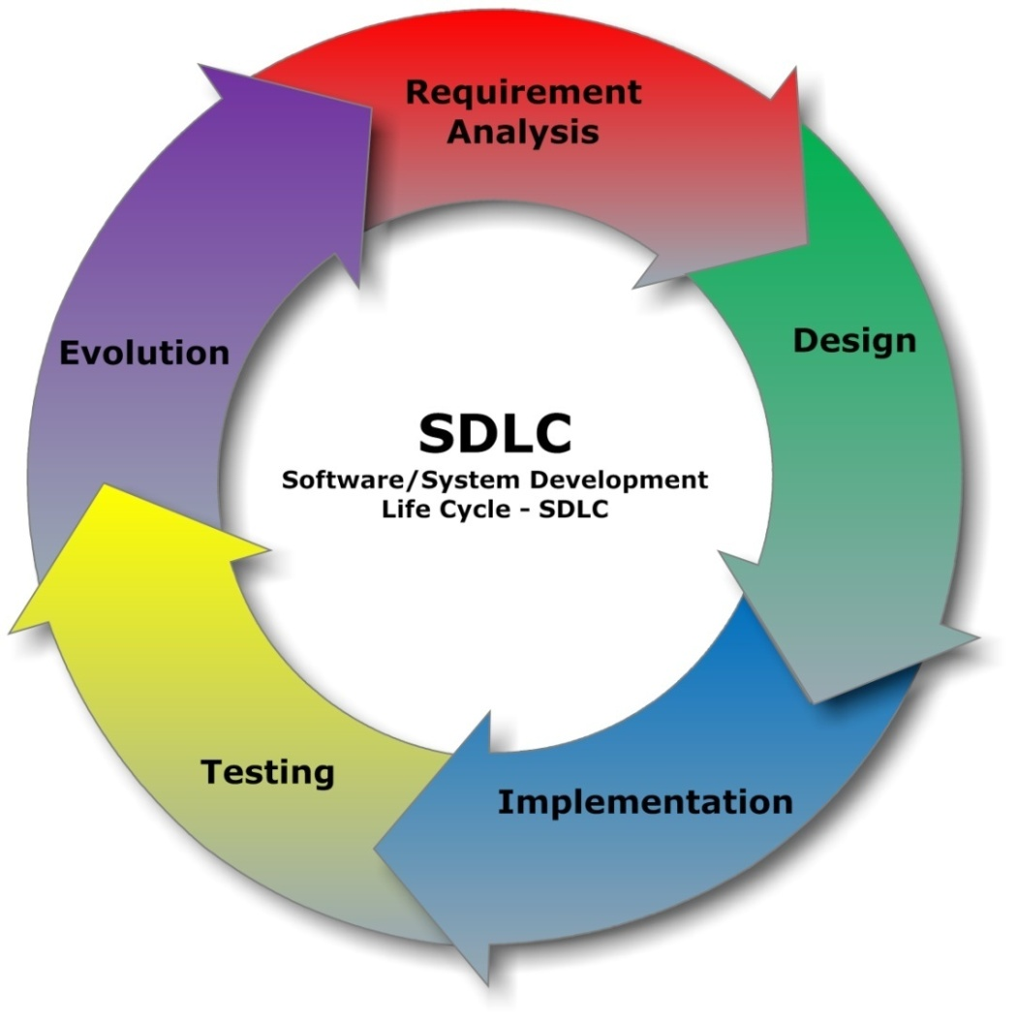
System implementation Plan
A. Steps(SDLC Cycle):

Slide 52
PROJECT SCHEDULING
Table for track of the project milestones & to find out whether we achieve preset targets
No. | SCHEDULE | PLANNED DURATION | ACTUAL DURATION
1. | Searching and Selection of Topic | 06/06/2012 TO 20/06/2012 | 06/06/2012TO25/06/2012
2. | Problem Definition | 21/06/2012 TO 22/06/2012 | 24/06/2012 TO 26/06/2012
3. | Literature Survey | 23/06/2012 TO 30/06/2012 | 26/06/2012 TO 02/07/2012
4. | Technical Study | 01/07/2012 TO 30/08/2012 | 03/07/2012 TO 04/09/2012
5. | Project Plan | 01/09/2012 TO 05/09/2012 | 05/09/2012 TO 07/09/2012
6. | Requirement Analysis | 09/09/2012 TO 20/09/2012 | //2012 TO //2012
7. | Coding and Implementation | 21/09/2012 TO 13/02/2012 | //2012 TO //2012
8. | Testing | 21/10/2012 TO 28/02/2012 | //2012 TO //2012
9. | Modifications | 26/01/2012 TO 20/03/2012 | //2012 TO //2012
10. | Project Completion and Report | 20/04/2012 TO 30/04/2012 | //2012 TO //2012

Slide 53
SYSTEM DESIGN

Slide 54
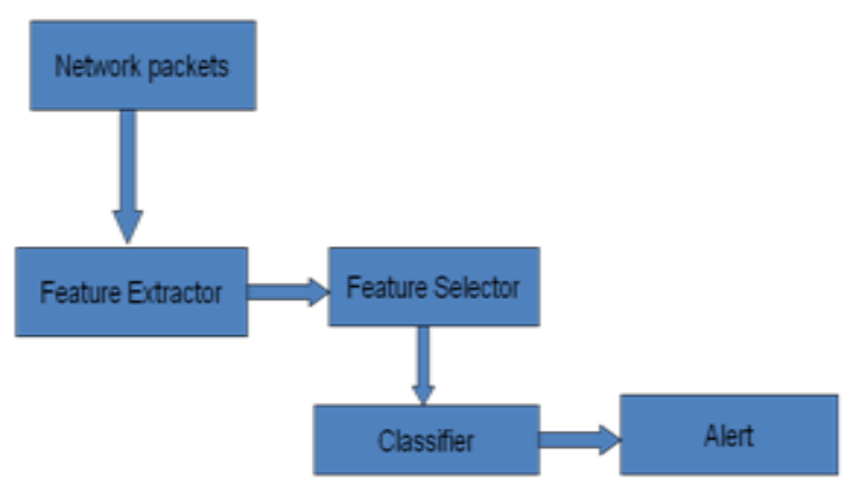
System Architecture

Slide 55
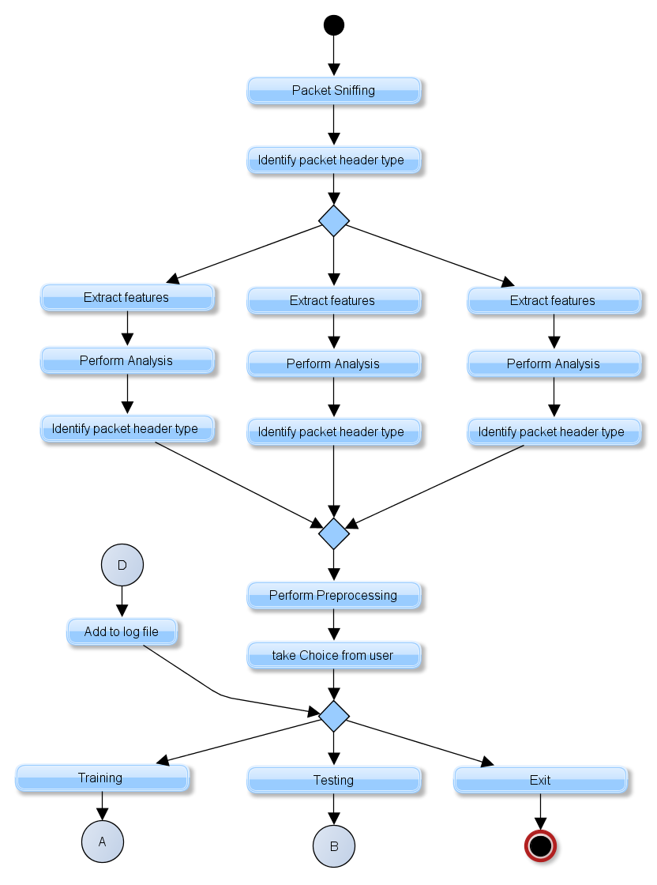
UML diagrams
Activity diagram
(Preprocessing)

Slide 56
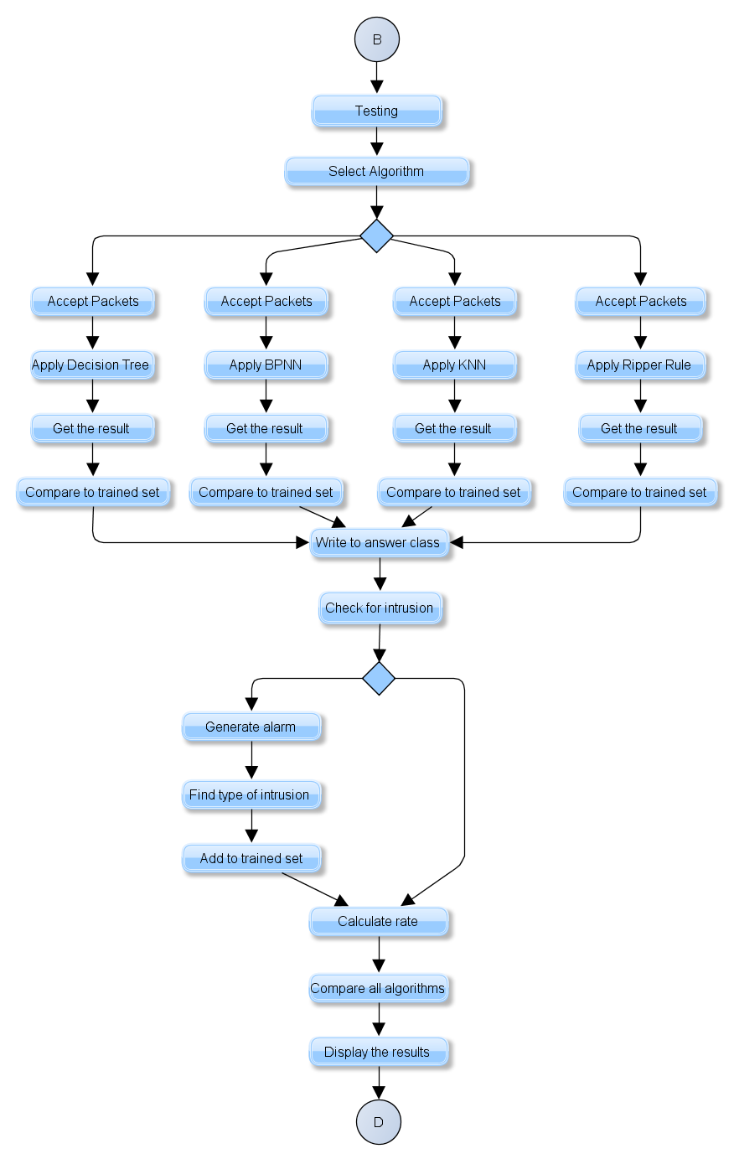
Activity diagram
(Training)

Slide 57
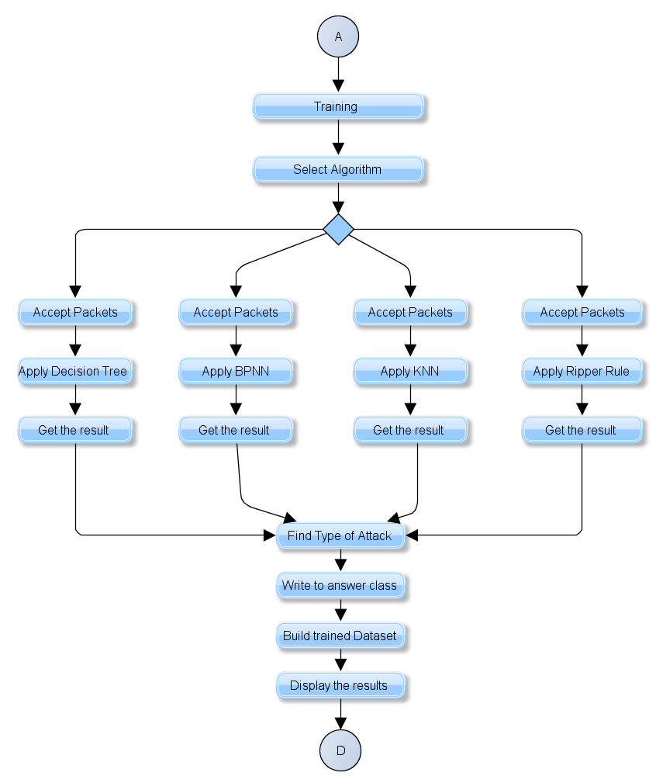
Activity diagram
(Testing)

Slide 58
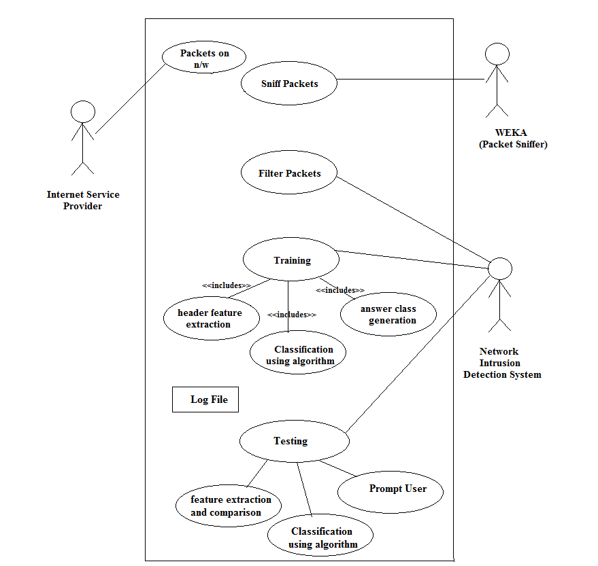
B. Use case Diagram

Slide 59
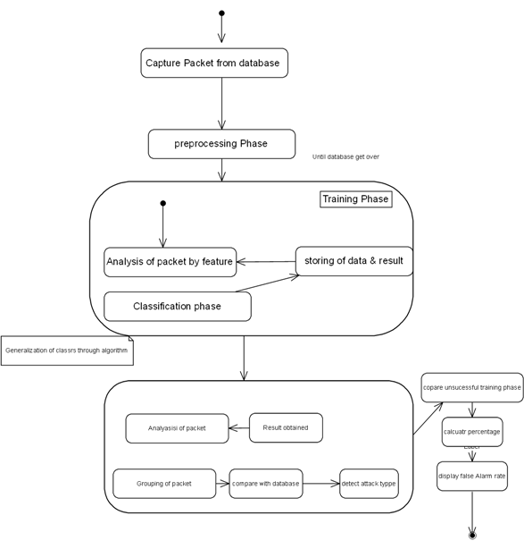
C. State Transition Diagram

Slide 60
Technical Specification

Slide 61
Advantages
Gives Security to data
Less Hardware Dependency
Constant Network Monitoring
Versatility of the System
Use of 4 different algorithms making it improve performance
Machine learning technology making it update itself

Slide 62
Disadvantages
Performance can not be guaranteed as the problem is NP hard
Packet Sniffing tool is necessary

Slide 63
Future Scope
This NIDS could be expanded to take data directly from network, instead of sniffers in between
Improved rate of detection
Decreased False Alarm Rate

Slide 64
Applications
Intrusion Prevention System
Protocol Based Intrusion detection system
Security tools
Firewall

Slide 65


